Slide 1
HUA Human research protection program

Slide 2
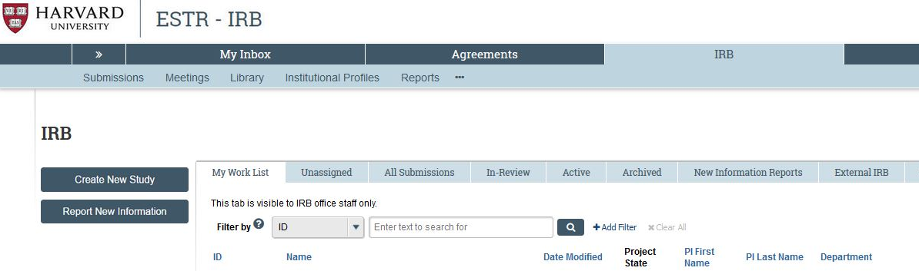
ESTR Website (irb.Harvard.edu)
This is where you can find documents (e.g., SOP's, Worksheets, and Checklists) that are part of our HRPP "Toolkit"

Slide 3
Required reading
Human research protection Program plan
HRP-101 (ESTR Library → General)
The purpose of this plan is to describe this Institution’s plan to comply with ethical and legal requirements for the conduct and oversight of Human Research.
The Human Research Protection Program is based on all individuals in this Institution along with key individuals and committees fulfilling their roles and responsibilities described in this plan.

Slide 4
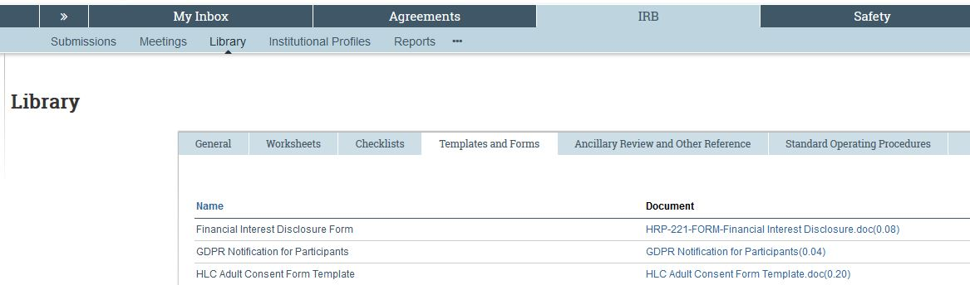
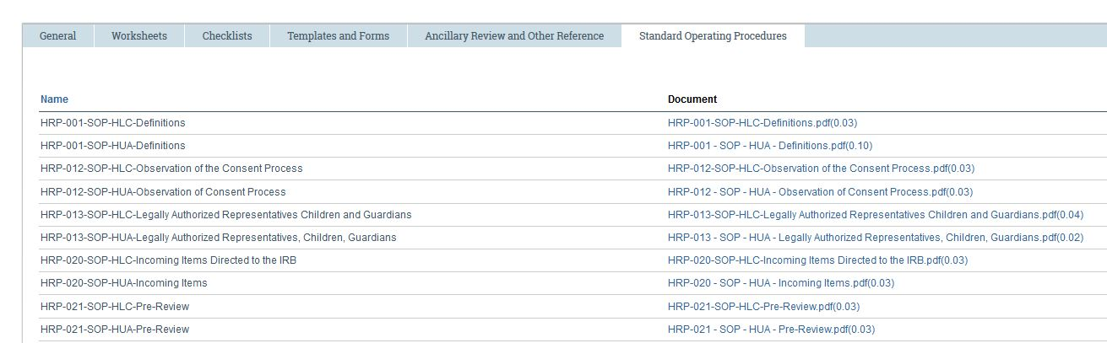
estr library
Within the ESTR Library, there are various tabs according to the "type" of documents

Slide 5
most Relevant documents
Worksheets tab
Checklists tab
HRP-309: HUA Harvard Policies
  See also Provostial Harvard Policies cheat sheet
HRP-334: Genetic Resources
HRP-335: Provostial Review
None

Slide 6
most Relevant documents
Templates and forms tab
Ancillary review and other reference tab
None
None

Slide 7
most Relevant documents
Standard operating procedures
HRP-012: Observation of Consent Process
HRP-025: Investigations
HRP-026: Suspension or Termination Issued Outside Convened IRB
HRP-044: Not Otherwise Approvable Research
HRP-054: Institutional Conflicts of Interest
HRP-064: NIH GDS Institutional Certification
HRP-080: IRB Formation and Registration
HRP-081: IRB Removal
HRP-082: IRB Membership Appointment
HRP-083: IRB Membership Removal
These SOP’s include an action required by the IO

