Slide 1
HUA Human research protection program

Slide 2
AAHRPP

Slide 3

What is AAHRPP?
AAHRPP: Association for the Accreditation of Human Research Protection Programs
MISSION: “AAHRPP accredits high-quality human research protection programs in order to promote excellent, ethically sound research. Through partnerships with research organizations, researchers, sponsors, and the public, AAHRPP encourages effective, efficient, and innovative systems of protection for human research participants.”

Slide 4
AAHRPP Principles
What AAHRPP expects from Organizations
CLIMATE
  Organization should promote research environment where ethical, productive investigation is valued
SAFETY NET
  Protecting research participants is the responsibility of everyone, not just the IRB
THE EXTRA MILE
  Striving to exceed federal requirements and continually seeking new safeguards

Slide 5
Resources

Slide 6
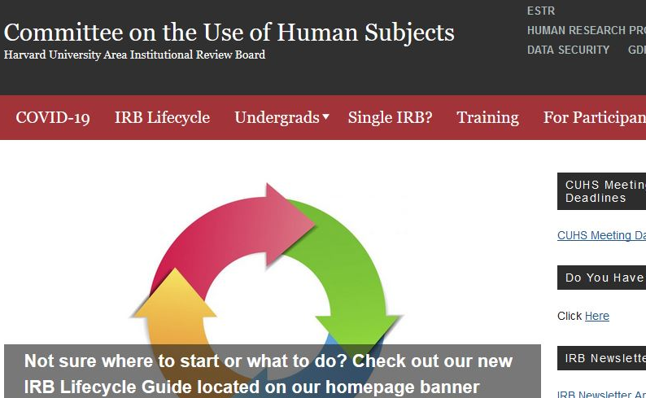
CUHS website
(cuhs.Harvard.edu)

Slide 7
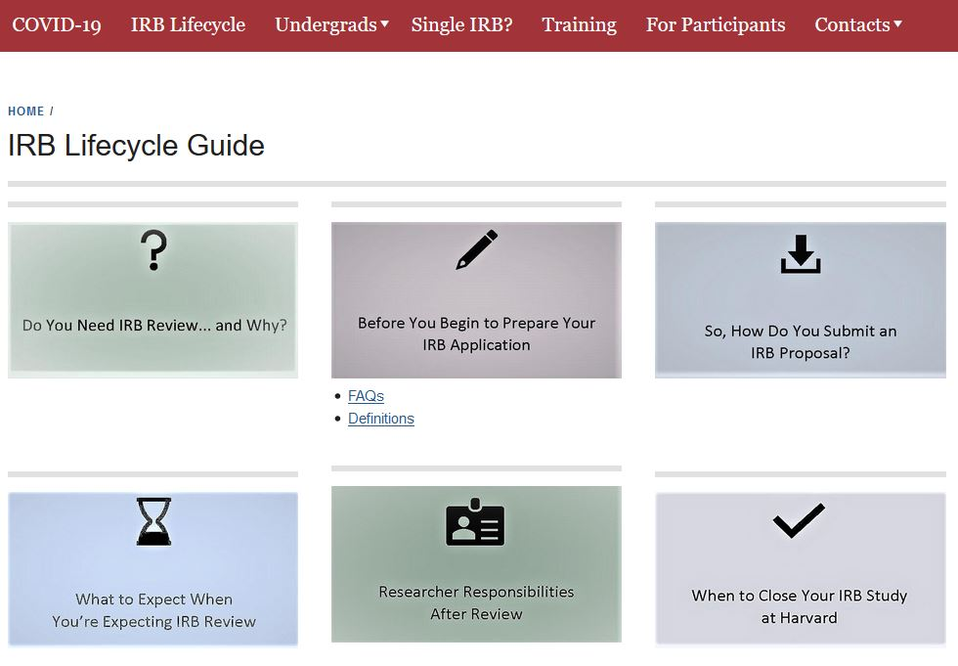
IRB Lifecycle
(cuhs.Harvard.edu)

Slide 8
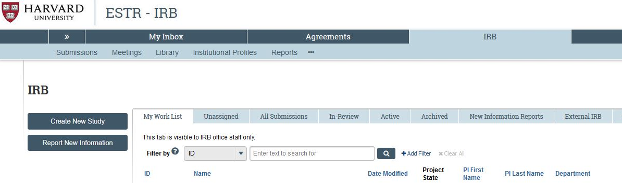
ESTR Website (irb.Harvard.edu)

Slide 9
Essential reading
Human research protection Program plan
Investigator manual
HRP-101 (ESTR Library → General)
The purpose of this plan is to describe this Institution’s plan to comply with ethical and legal requirements for the conduct and oversight of Human Research.
The Human Research Protection Program is based on all individuals in this Institution along with key individuals and committees fulfilling their roles and responsibilities described in this plan.
HRP-103 (ESTR Library → General)
The Investigator Manual is designed to guide investigators and study staff through policies and procedures related to the conduct of Human Research that are specific to the Harvard University Area (HUA) IRB office.
General information regarding Human Research protections, as well as relevant federal regulations and guidance, has been incorporated throughout the manual where applicable.

Slide 10
Human Research Protection Program (HRPP) Plan

Slide 11
HRPP Mission
The mission of this Institution’s Human Research protection program plan is to protect the rights and welfare of subjects involved in Human Research that is overseen by this Institution.

Slide 12
HRPP SCOPE
All research (whether funded or not, and regardless of funding source) involving human subjects conducted by investigators under the auspices of the University-Area Institutions.
See HRP-101 HUA Human Research Protection Program Plan for specific categories of research overseen and not overseen

Slide 13
Ethical requirements
Outlined in 1979 “Ethical Principles and Guidelines for the Protection of Human Subjects of Research,” also known as “The Belmont Report”
Institutional baseline for all researchers, IRBs, and associated staff

Slide 14
The Belmont Report
Respect for Persons
  1) Individuals should be treated as autonomous agents,
  2) Persons with diminished autonomy are entitled to protection.
Beneficence
  1) Protecting the individual subjects against risk of harm
  2) Consideration of not only the benefits for the individual, but also the societal benefits that might be gained for research
Justice
  Who ought to receive the benefits of research and bear its burdens? This is a question of justice, in the sense of "fairness in distribution" or "what is deserved."

Slide 15
Legal requirements
Ensure all Human Research undergoes review by designated IRB
Apply Common Rule (45 CFR 46)
Apply additional regulations of relevant federal funding agency
  See HRP-318 WORKSHEET Additional Federal Agency Criteria
  See HRP-103 Investigator Manual
Apply FDA regulations when applicable

Slide 16

Key Players in hrpp plan
ALL MEMBERS OF THE INSTITUTION
INSTITUTIONAL OFFICIAL (IO)/ ORGANIZATIONAL OFFICIAL (OO)
HUA IRB/CUHS
INVESTIGATORS AND RESEARCH STAFF
OFFICE OF GENERAL COUNSEL (OGC)
OFFICE FOR SPONSORED PROGRAMS (OSP)
OFFICERS/DEANS

Slide 17
All Members of the Institution
All individuals within the Institution have the responsibility to:
  Be aware of the definition of Human Research.
  Consult the IRB when there is uncertainty about whether an activity is Human Research.
  Not conduct Human Research or allow Human Research to be conducted without review and approval by an IRB designated by the IO/OO.
  Report allegations of undue influence regarding the oversight of the Human Research Protection Program or concerns about the Human Research Protection Program to the IO/OO.
  Report allegations or finding of non-compliance with the requirements of the Human Research Protection Program to the IRB.

Slide 18
INSTITUTIONAL OFFICIAL/ORGANIZATIONAL OFFICIAL
Authority over
Overall Responsibility for
IRB budget
IRB membership and staffing
Reliance agreements
PI restrictions
Suspend, terminate, disapprove research
NOTE: May delegate these authorities (generally to IRB Director, Shannon Sewards)
IRB reviews conducted by HRPP
HRPP policies/procedures
HRPP training initiatives
Independence of IRB from Institution
Report of complaints/concerns about research, as well as from IRB Chairs and Members
Signatory of the Federalwide Assurance (FWA)
See HRP-101 HUA Human Research Protection Program Plan for more information on the IO/OO

Slide 19
What is an IRB?
An Institutional Review Board is responsible for reviewing all research that involves human subjects
Enforce the Federal Regulations for the Protection of Human Subjects and other state and local regulations as they apply
IRBs have the authority to approve, disapprove, suspend, and terminate research involving human subjects

Slide 20

Institutional Review Board (IRB)
Panel of individuals from various backgrounds:
  Regulatory experts, scientists, faculty
  Diverse in race, gender, cultural background, etc.
  At least one:
    Prisoner representative
    Non-affiliated community member
Harvard University-Area IRB/ Committee on the Use of Human Subjects (CUHS)
Meets once per month

Slide 21
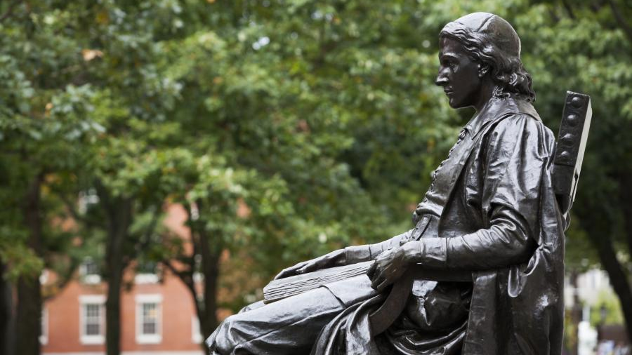
Harvard university area (“institution”)
Faculty of Arts and Sciences
John F. Kennedy School of Government
Harvard Graduate School of Education
Harvard Law School
Harvard Divinity School
Harvard Graduate School of Design
Harvard University Health Services
Radcliffe Institute for Advanced Study
Harvard School of Engineering and Applied Sciences
Harvard Business School

Slide 22

Principal Investigator Responsibilities
  Follow the Human Research Protection Program requirements described in HRP-103 Investigator Manual
  Comply with all determinations and additional requirements of the IRB, IRB chair, and IO/OO

Slide 23
Principal Investigator Responsibilities
Secure IRB approval prior to implementation
Conduct study according to IRB approved protocol
Submit Continuing Review, Modifications to IRB as required
Ensure adequate facilitates, equipment on site
Ensure study staff are qualified
Report new information

Slide 24
Study Staff Responsibilities
Human SubjectS Training
Conduct study according to IRB approved protocol
Report any discrepancies/issues/subject complaints to supervisor/PI and the IRB
NOTE: CITI training is the most used human subjects training. Training last 3 years.
More information on training options may be found at: https://cuhs.harvard.edu/required-ethics-training

Slide 25
OGC Responsibilities
  Provide advice upon request
  Determine whether someone is acting as an agent
  Determine who meets the definition of “legally authorized representative” and “children” when Human Research is conducted in jurisdictions not covered by policies and procedures
  Resolve conflicts among applicable laws
  Institutional adherence to EEA General Data Protection Regulations (GDPR)

Slide 26

OSP Responsibilities
OSP has the responsibility to review contracts and funding agreements for compliance with Human Research Protection Program policies and procedures

Slide 27
OFFICERS/DEANS
Oversee
Oversee the review and conduct studies in their department or school
Forward
Forward complaints and allegations to IRB or IO/OO
Ensure
Ensure studies conducted in their department or school has adequate resources

Slide 28
Possible Questions
Who is the IO and what do they do?
  Ara Tahmassian, Assistant Vice Provost for Research
What is the mission of the HRPP?
What are the components of the HRPP?
What does your division/department do to support human research activities?
REMEMBER, your role is part of a larger effort to protect human subjects in research. How does your role contribute to that effort?

Slide 29
Does my project require irb review?
The common Rule

Slide 30
Does my project require irb review?
Research?
Involve Human Subjects?
Exempt?
Expedited?
Convened IRB

Slide 31


What requires IRB review? /
What is research?
Systematic investigation
Generalizable knowledge

Slide 32
What requires IRB review?
  A systematic investigation involves:
    Methodical procedure and plan
    Theoretically grounded
    Well-defined research question
    Informed by empirical findings

Slide 33
What requires IRB review?
Results applicable to population beyond data collection site or specific subjects studied
and/or
Results intended to be used to develop, test, or support theories, principles, and statements of relationships, or to inform policy beyond the study

Slide 34
Not (Regulated) Research
Additionally
  Case studies
  Journalism/documentary activities
  Oral history
  Standard public health surveillance or prevention activities
  Criminal justice investigations
  National intelligence/security missions
  Secondary use of non-identifiable newborn screening blood spots

Slide 35

Does my project require irb review?
Research?
Involve Human Subjects?
Exempt?
Expedited?
Convened IRB

Slide 36


Human Subjects Research
Human Subject
A living individual about whom an investigator:
OR
Uses information from intervention or interaction with the individual
Uses private, identifiable information

Slide 37

Not human subjects Research
Secondary analysis of publicly available data sets
Secondary analysis of de‐identified data sets stripped of all identifiable information

Slide 38
Levels of Review
Research?
Involve Human Subjects?
Exempt?
Expedited?
Convened IRB

Slide 39
Who reviews what
CONVENED IRB/Full board
Staff members
(who are Alternate IRB Members)
Review approx. 5% of studies
Greater than Minimal Risk
Unknown Risk
Does not fit into Expedited or Exempt regulatory category
Review approx. 95% of studies
Expedited Approvals
Exempt Determinations
Not Engaged Determinations
Not Human Subjects Research Determinations
Not Research Determinations

Slide 40
Human Subjects Research
For more on the DHHS definitions of research and human subject see:
HRP-101 HUA Human Research Protection Program Plan
HRP-103 HUA Investigator Manual
HRP-310 WORKSHEET Human Research Determination
“Do You Need IRB Review…and Why?” in the IRB Lifecycle at cuhs.harvard.edu

Slide 41
Possible Questions
What is ethical research?
What are the three fundamental ethical principles of the Belmont Report? When was the first time you heard of the Belmont Report?
What is the Common Rule (45 CFR 46)?

Slide 42
Reporting and Management of Concerns

Slide 43

Reporting and Management of Concerns
Questions, concerns, complaints, allegations of undue influence, allegations or findings of non-compliance, or input regarding the HRPP may be reported orally or in writing
The IRB has the responsibility to investigate allegations and findings of non-compliance and take corrective actions
The IO/OO has the responsibility to investigate all other reports and take corrective actions
UPIRTSO: Unanticipated Problem Involving Risks to Subjects or Others
Report within 5 days

Slide 44


WHEN UPIRTSO?
+HARMS
+RISKS

Slide 45


WHEN UPIRTSO?
AUDIT
NON-COMPLIANCE

Slide 46


WHEN UPIRTSO?
PROTOCOL NONADHERENCE
STUDY MONITOR

Slide 47


WHEN UPIRTSO?
ELIMINATE HAZARD
BREACH

Slide 48


WHEN UPIRTSO?
COMPLAINT
INCARCERATION

Slide 49


WHEN UPIRTSO?
ADVERSE DEVICE
SUSPENSION/ TERMINATION

Slide 50
Reporting and Management of Concerns
Contact the IRB office with questions (cuhs@harvard.edu)
Submit Report of New Information (RNI) in ESTR
Contact the IO/OO
  Ara Tahmassian, Ph.D. (ara_tahmassian@harvard.edu)

Slide 51
IRB DETERMINES
Not noncompliance or an unanticipated problem
Minor noncompliance: Noncompliance that is neither serious nor continuing
An unanticipated problem involving risks to subjects or others
Serious or continuing non-compliance with the regulations or the requirements or determinations of the IRB
Necessitates suspension or termination of IRB approval

Slide 52
Reporting and Management of Concerns
For more on reporting see:
HRP-101 HUA Human Research Protection Program Plan
HRP-103 HUA Investigator Manual
HRP-321 WORKSHEET Review of Information Items
“Researcher Responsibilities After Review” in the IRB Lifecycle at cuhs.harvard.edu

Slide 53
POSSIBLE QUESTIONS
In a dispute between IRB and a researcher, can an administrator overrule IRB’s decision?
How do you handle complaints regarding the IRB system?
To whom do you go to for help on issues, be they regulatory or ethical?

Slide 54
conflict of interest

Slide 55

Conflict of Interest
Financial or other personal considerations compromise, or have the appearance of compromising, an individual’s professional judgment in proposing, conducting, supervising or reporting research
Anything that may bias scientific objectivity
Examples:
  Consulting relationship with research sponsor
  Intellectual property interests in the research
  Equity interests in the research

Slide 56
Financial Conflict of Interest
The IRB requires that all individuals involved in the design, conduct, or reporting of the research report financial interests related to the research. See:
  HRP-221 FORM Financial Interest Disclosure
  HRP-309 WORKSHEET HUA Harvard Policies

Slide 57
Harvard fCOI
Each School’s policy is outlined in a School Implementation Plan
Individuals have institutional responsibility and are subject to this procedure when they have fCOI
Violations can lead to:
Related records to be retained for at least 3 years from completion of Human Research
Loss or restriction of privileges to conduct Human Research
Other employment actions

Slide 58
IRB PROCEDURES
Step 1
Obtain HRP-221 FORM Financial Interest Disclosure
Step 2
Trigger Ancillary Review process to the School fCOI Officer in ESTR
Step 3
Obtain fCOI approval and written management plan; coordinate any necessary revisions with School fCOI Officer
Step 4
Maintain a copy of determinations and management plans in the ESTR study record.

Slide 59
POSSIBLE QUESTIONS
Do you understand the HUA COI policies and how COIs may influence the protection of human research participants?
What is your role in managing conflicts of interest and institutional conflict of interest?

Slide 60
BONUS: Additional considerations

Slide 61
Principal Investigator Eligibility
Schools develop criteria
Based on who can receive funds through University
Researchers who are not PI-eligible (e.g., students) may be PI on IRB application with PI-eligible Faculty Sponsor
See HRP-103 HUA Investigator Manual and HRP-309 WORKSHEET HUA Harvard Policies

Slide 62
Additional Policy Considerations
Harvard Research data Security Policy (HRDSP)
Provostial Review
The IRB’s responsibility is to assign a level of sensitivity (Non-Sensitive or Sensitive) based data collected/used in the research and described in the IRB application
For research studies that may pose management challenges and/or reputational risk
Separate and distinct from IRB review
Most often Expedited review and take place in a foreign country or studies that may cause a reputational risk to the university
For more information see HRP-309 WORKSHEET HUA Harvard Policies, HRP-335 WORKSHEET Provost Review, and HRP-336 WORKSHEET Harvard Research Data Security Level Decision Aid

Slide 63

Additional Harvard policies & procedures
Principal investigator (PI) eligibility
  Waiver of PI requirement
  Faculty Sponsor assurance
Harvard Research Data Security Policy
Genomic Data Sharing Policy
Human embryonic stem cells/use of fresh fetal tissue
Transfer of materials (Material Transfer Agreement)
Transfer of data (Data Use Agreement)
Use of Harvard Name Policy
Human Subject Payment Policy
Harvard Conflict of Interest Policy

Slide 64
Additional Harvard policies & procedures
Committee on Microbiological Safety (COMS)
Radiation Safety Committee (RSC)
Targeting Harvard students
  Harvard College
  Harvard Law School
  Graduate students and employees
Study pools:
  Psychology Study Pool
  Harvard Decision Science Lab (HDSL)
  HBS Computer Lab for Experimental Research (CLER)
  Harvard Digital Lab for the Social Science (DLABSS)
Provostial Review
General Data Protection Regulation (GDPR)

Slide 65
Additional Harvard policies & procedures
See HRP-309-WORKSHEET-HUA Harvard Policies for more information on some of these policies and how the HUA IRB facilitates required ancillary reviews

